Slide 1
Industrial Big Data Analytics (MECH6078) Assignment 4&5
Cyrus Azamfar
Ravi Teja Telkapally
Siddartha Patlori
Krishna Kumar Chandran

Slide 2
Support Vector Machine
Training Data
Test Data
Feature Extraction
Feature Extraction
Time Domain Features
Frequency Features
Time Domain Features
Frequency Features
Feature Selection
Feature Selection
Train SVM Model
SVM Model
Cross Validation of SVM methods
Testing Model
Plot confusion matrix

Slide 3
SVM Procedure:
Import the training data and the testing data. Generate a feature matrix with the time domain and frequency domain features (First, Second, Third frequency).
Selection of the features is done using the fisher selection algorithm. Top two features are used to run the SVM algorithm.
Cross validation is done to select the best SVM method, by selecting the 75% of the training data for training the method and 25% of the training data for testing the method. From the results the best suited method is selected to run the SVM algorithm.
The results are plotted in the graph.

Slide 4
Support Vector Machines
Classification of data
Using Gaussian Radial Basis Function (RBF)
Only two set of data at a time

Slide 5
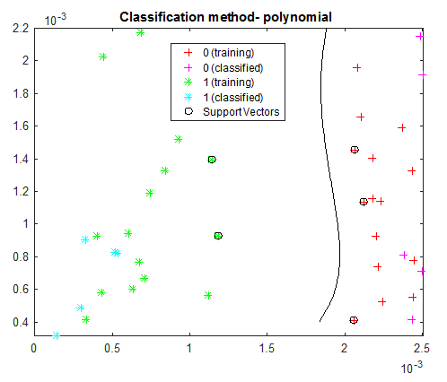
Support Vector Machines
Classification of data
Using Polynomial Function

Slide 6
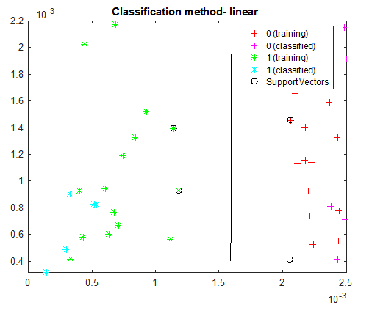
Support Vector Machines
Classification of data
Using Linear Function

Slide 7
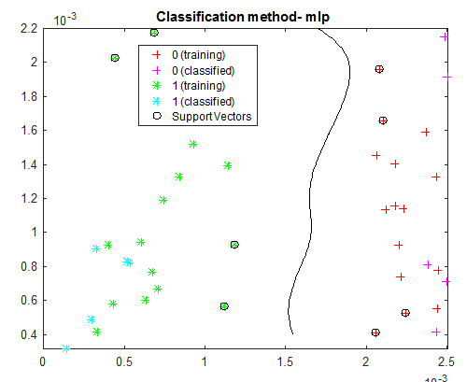
Support Vector Machines
Classification of data
Using Multilayer Perceptron kernel (MLP)

Slide 8
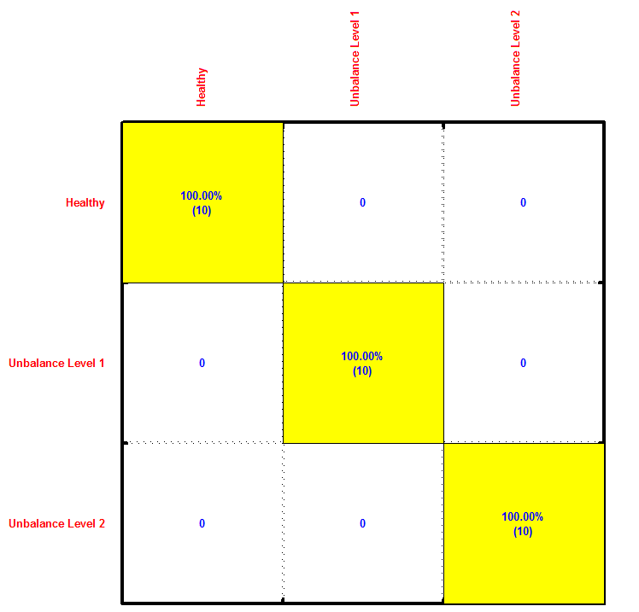
Support Vector Machines
Confusion Matrix

Slide 9
Self Organizing Maps
Training Data
Test Data
Feature Extraction
Feature Extraction
Time Domain Features
Frequency Features
Time Domain Features
Frequency Features
Feature Selection
Feature Selection
Train SOM Map Based on Healthy Data (Baseline)
SOM Model
Testing the data using MQE

Slide 10





Self Organizing Maps

Slide 11
Self Organizing Maps

Slide 12
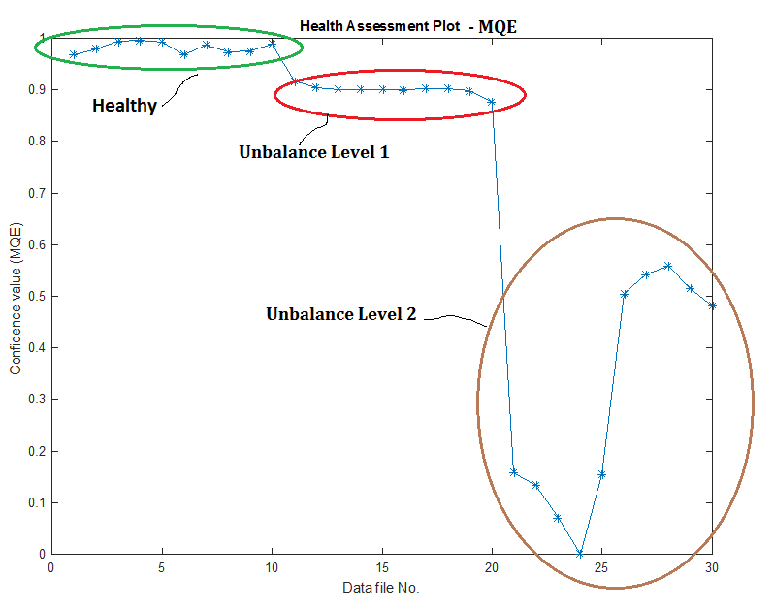
Self Organizing Maps

Slide 13
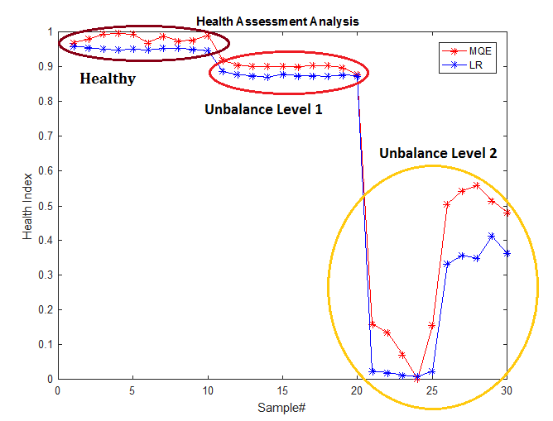
Self Organizing Maps
Comparison of SOM-MQE and Logistic regression

Slide 14
Thank you

